Slide 1


Practicum Presentation: 1st Defense Topic: “Human Brain Activity Classification”
Students Name, Enrolment No. Branch & Section:
Utsav Singhal, 02917711622, AIML-A
Saarthak Bansal, 03917711622, AIML-A
Chakshu Gupta, 05817711622, AIML-A
Dhairya Goel, 06117711622, AIML-A
Supervisor: Dr. Monika Bansal

Slide 2

Index of Contents
Introduction & Motivation
Problem Statement
Background Study
Technology Stack
Project Progress/Implementation
Aim for the coming weeks
References

Slide 3
1. Introduction & Motivation
Neurological illnesses present considerable obstacles in the provision of patient care, frequently requiring prompt and accurate action to minimize potential injury. Electroencephalography (EEG) is a strong non-invasive method for real-time monitoring of brain activity among the diagnostic instruments available. EEG recordings are essential for diagnosing patients with neurological diseases, such as seizures, periodic discharges, or other unusual brain activity, in critical care settings like hospitals.

Slide 4
2. Problem Statement
The goal of this project is to create an advanced machine learning system that can use EEG signals from hospitalized critically ill patients to identify and categorize different types of hazardous brain activity. The goal includes classifying any additional abnormal patterns that may surface from the EEG data, as well as recognizing seizures, lateralized periodic discharges, generalized periodic discharges, lateralized rhythmic delta activity, and generalized rhythmic delta activity

Slide 5
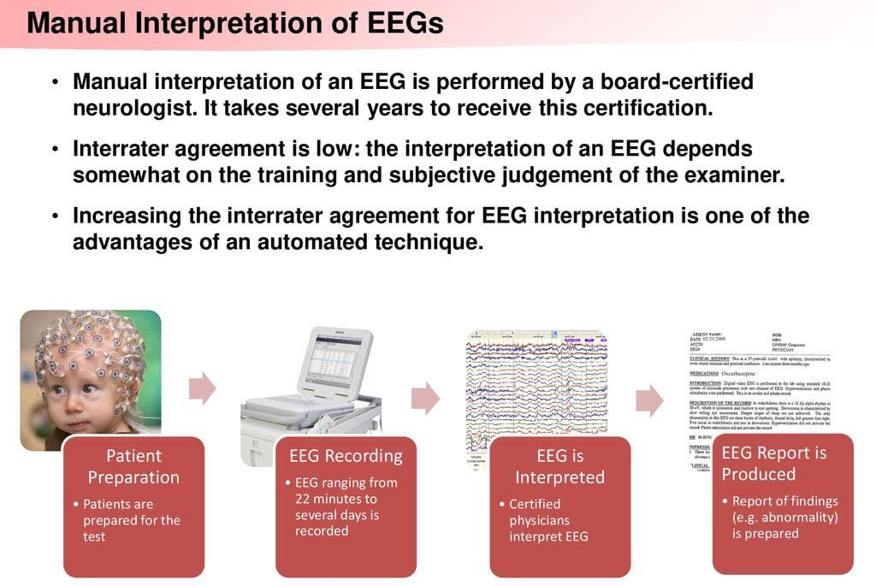
2. Problem Statement

Slide 6
3. Background Study
Accurate identification and management of seizures and hazardous brain activity is crucial in critical care to reduce the risk of in-hospital mortality.
Advanced machine learning techniques, particularly Convolutional Neural Networks (CNNs), are employed to enhance EEG analysis for real-time monitoring.
CNNs are adept at capturing spatial relationships but may face challenges with the intricate dynamics present in EEG signals.
Despite resource-intensive training requirements, studies have shown CNNs' effectiveness in detecting seizures and abnormal patterns.
Recursive Neural Networks (RNNs), particularly Long Short-Term Memory (LSTM) networks, hold promise in capturing temporal dependencies in EEG data.
LSTM models have successfully identified diverse EEG patterns from invasive and non-invasive recordings, indicating their potential to transform neurological care in critical settings.
These advancements highlight the importance of integrating state-of-the-art machine learning techniques to improve patient outcomes and refine critical care protocols.

Slide 7
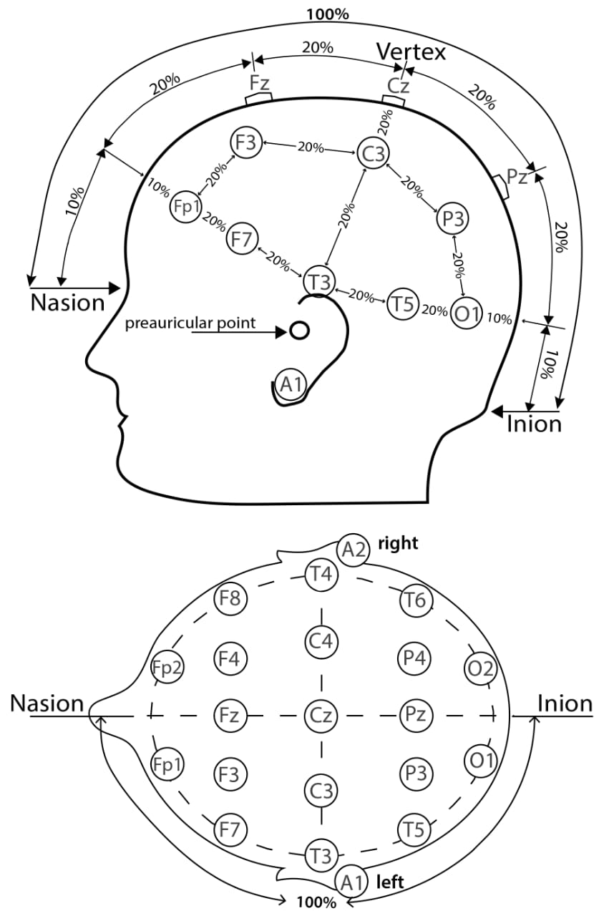
Fp1, Fp2: Frontal pole electrodes are on the left and right side of the forehead.
F3, F4: Forehead electrodes located on the left and right side of the forehead.
C3, C4: central electrodes, in the left and right hemispheres of the brain.
P3, P4: parietal electrodes, left and right of the back of the head.
O1, O2: Occipital electrodes are located at the back of the head, near the visual cortex.
T3, T4, T5, T6: Temporary electrodes located on the left and right sides of the head, near the ears. They often participate in monitoring the performance of the voice.
F7, F8: Frontotemporal electrodes, in front of the temporal lobe.
Fz, Cz, Pz: midline electrodes are located at the frontal (Fz), central (Cz) and parietal (Pz) locations in the middle of the head.

Slide 8
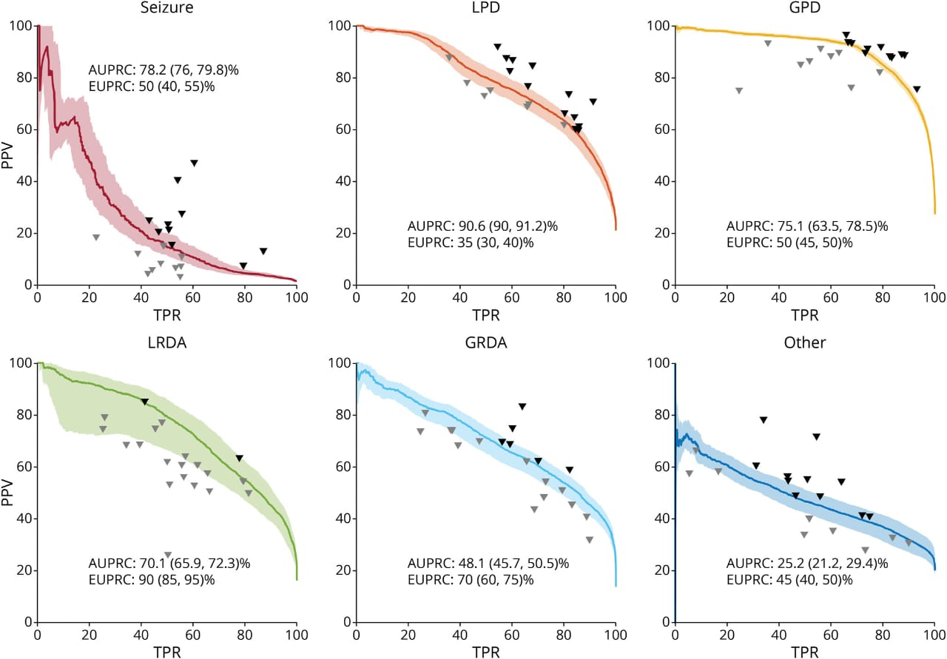
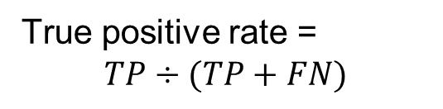
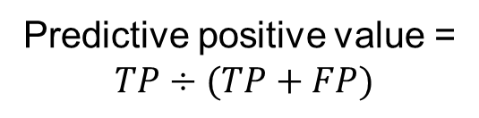
Predictive positive value =
$$TP÷(TP+FP)$$
True positive rate =
$$TP÷(TP+FN)$$

Slide 9
4. Technological Stack
(a) Software:
1) Python (programming language)
2) Jupyter Notebook or JupyterLab (for interactive development and experimentation)
3) IDEs (Integrated Development Environments) such as PyCharm, Spyder, or VSCode (for code development)
4) Version Control System: Git & Github (for collaborative development and version control)
(b) Modules/Libraries:
1) NumPy: Array manipulation.
2) SciPy: Scientific computing.
3) MNE-Python: EEG data processing.
4) PyEEG: EEG feature extraction.
5) scikit-learn: Machine learning algorithms.
6) TensorFlow/PyTorch: Deep learning frameworks.
7) Matplotlib: Data visualization.
8) Seaborn: Statistical visualization.
9) Pandas: Data manipulation.
10) Keras: Neural networks API.
11) XGBoost/LightGBM/Catboost: Gradient boosting.
12) H2O.ai: Scalable ML platform.
13) NiLearn: Neuroimaging analysis.
14) TensorBoard: Model visualization.
15) Dask: Parallel computing.

Slide 10
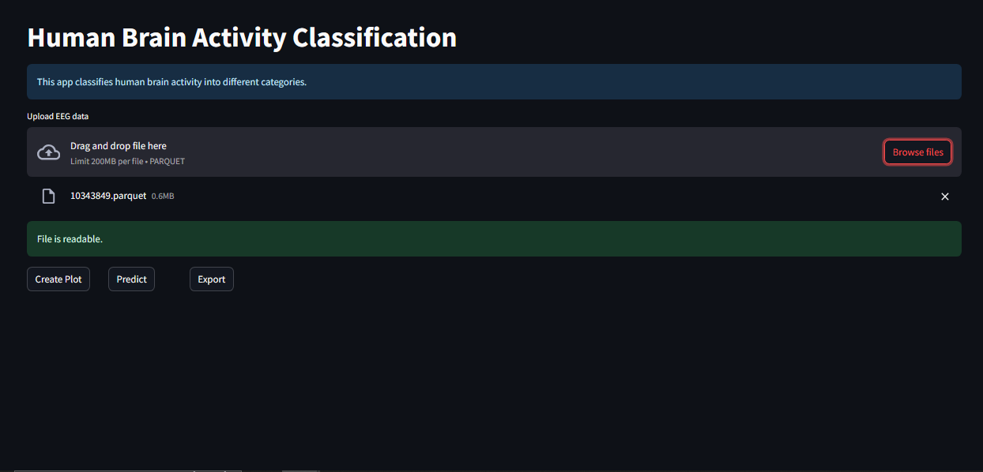
5. Project Progress/Implementation
Frontend developed using Streamlit
Preprocessing and feature engineering completed
Implemented XGBoost and LightGBM models
Created .pkl files for model persistence

Slide 11
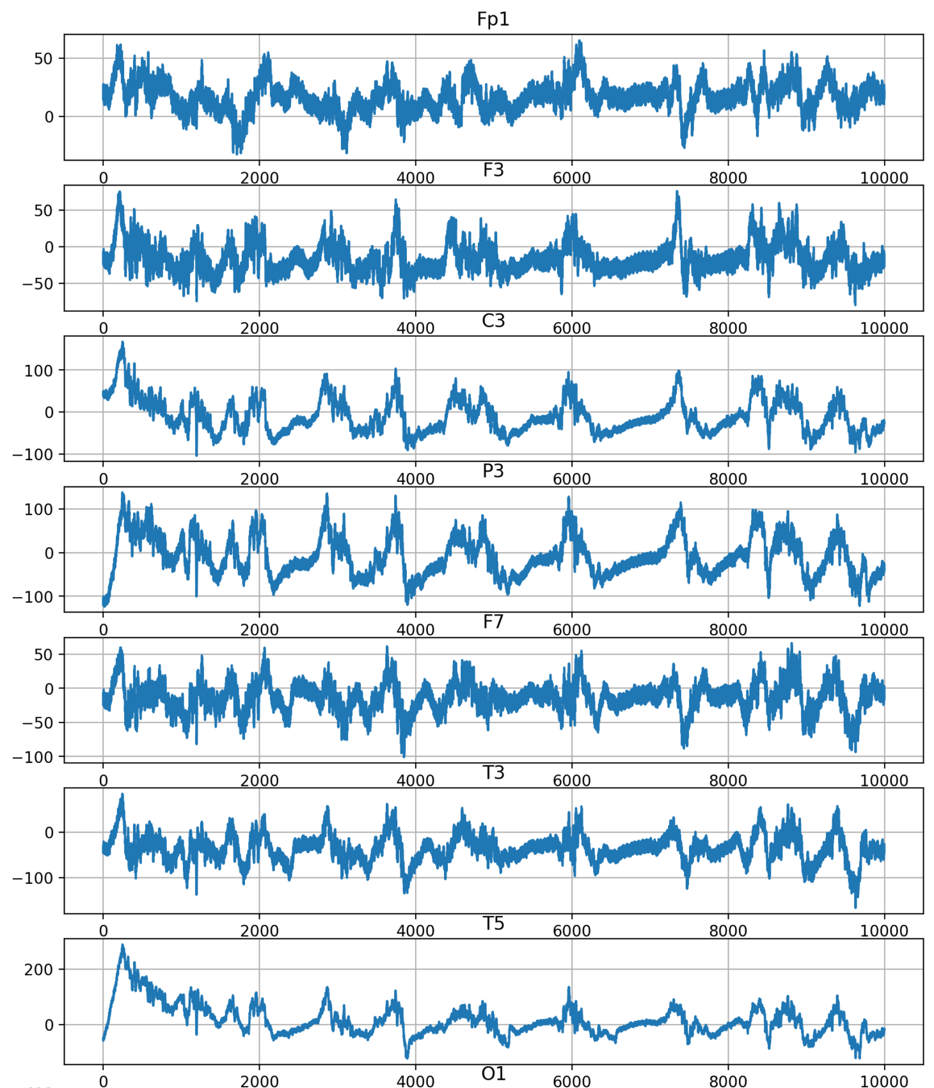
5. Project Progres/Implementation

Slide 12
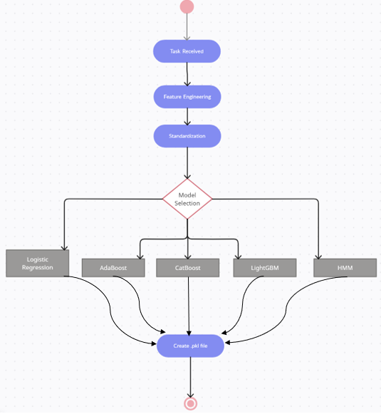
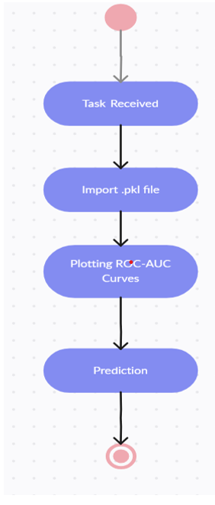
Figure 1: Pre-Processing and Training
Figure 2: Prediction

Slide 13
6. Aim for the coming weeks
- Complete frontend development
- Apply models: Logistic Regression, Hidden Markov Models (HMM), Gradient Boosting, etc.
- Implement deep learning models: ResNet, ResNeXt, VGG16, etc.

Slide 14
7. References
Houssein, E. H., Hammad, A., & Ali, A. A. (2022). Human emotion recognition from EEGbased brain–computer interface using machine learning: a comprehensive review. Neural Computing and Applications, 34(15), 12527-12557.
Vishwanath, M., Jafarlou, S., Shin, I., Dutt, N., Rahmani, A. M., Jones, C. E., ... & Cao, H. (2021, November). Investigation of machine learning and deep learning approaches for detection of mild traumatic brain injury from human sleep electroencephalogram. In 2021 43rd Annual International Conference of the IEEE Engineering in Medicine & Biology Society (EMBC) (pp. 6134-6137). IEEE.
Murtazina, M. S., & Avdeenko, T. V. (2020, December). Classification of brain activity patterns using machine learning based on EEG data. In 2020 1st International Conference Problems of Informatics, Electronics, and Radio Engineering (PIERE) (pp. 219-224). IEEE.
Craik, A., He, Y., & Contreras-Vidal, J. L. (2019). Deep learning for electroencephalogram (EEG) classification tasks: a review. Journal of neural engineering, 16(3), 031001.
Khosla, A., Khandnor, P., & Chand, T. (2020). A comparative analysis of signal processing and classification methods for different applications based on EEG signals. Biocybernetics and Biomedical Engineering, 40(2), 649-690.
Haselsteiner, E., & Pfurtscheller, G. (2000). Using time-dependent neural networks for EEG classification. IEEE transactions on rehabilitation engineering, 8(4), 457-463

